Slide 1
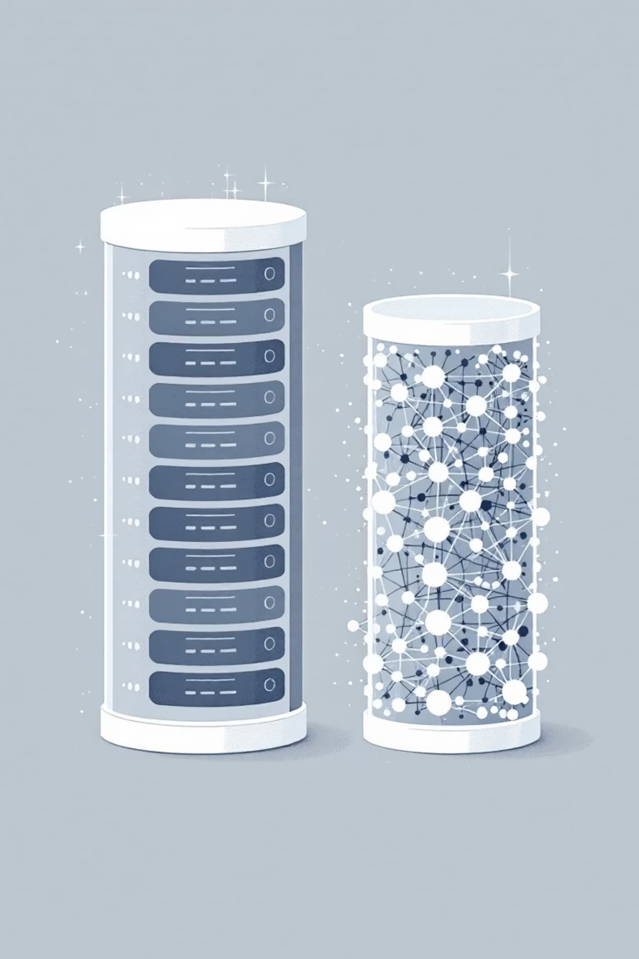

The Shift from Traditional to Gen AI Databases
Generative AI applications require a fundamentally different approach to storing and retrieving data compared to traditional applications. This presentation explores why vector embeddings are crucial and what factors to consider when choosing a Gen AI database.
For Trial
Notes:
**Speaker Note:**
"This slide highlights the key shift we're seeing: Generative AI demands a new database paradigm. Traditional databases aren't optimized for the nuances of Gen AI. We'll discuss why vector embeddings are so critical for performance, and then dive into the critical considerations for selecting the right Gen AI database solution." (Pause briefly) "Let's start by understanding the limitations of traditional approaches."

Slide 2

Traditional vs. Gen AI Databases
Traditional Databases
Gen AI Databases
Store structured data in rows and columns
Handle unstructured data (text, images, audio)
Find data by matching exact values
Understand meaning and context
SQL queries for precise matches (e.g., "find all carnivores")
Find semantically similar items
Rely on vector embeddings
For Trial
Notes:
**Speaker Note:**
"This slide contrasts traditional and Gen AI databases. Traditional databases excel at structured data and precise SQL queries for exact matches. Gen AI databases, on the other hand, handle unstructured data like text and images. They leverage vector embeddings to understand meaning and find semantically similar items. This is critical for use cases beyond exact data retrieval. For the trial, we'll demonstrate how Gen AI databases can extract insights and provide richer context that a traditional database simply cannot."

Slide 3



What Are Vector Embeddings?
A vector embedding converts unstructured data—like words, sentences, or images—into a list of numbers (a vector) representing its position in a high-dimensional space.
Unstructured Data
Embedding Process
Vector Database
Text, images, audio files
Convert to numerical vectors
Store in high-dimensional space
The key feature: semantically similar items are placed closer together in this space. For example, "lion" and "tiger" vectors would be close, while "car" would be far away.
For Trial
Notes:
**Speaker Note:**
"This slide defines vector embeddings. We're essentially transforming unstructured data like text, images, and audio into numerical vectors. These vectors are then stored in a high-dimensional space within a vector database. The core benefit is semantic similarity – items with similar meanings or characteristics end up clustered closer together in this space. Think of 'lion' and 'tiger' being near each other, while 'car' is distant. This is the foundation for the trial we'll discuss next."

Slide 4

Semantic Search with Vector Embeddings
Traditional Search
Semantic Search
"Find the animal named 'lion'"
"Find animals similar to a 'lion'"
Exact match required
Returns tigers, leopards, cheetahs
Misses related concepts
Understands relationships
Limited to structured data
Works with unstructured data
For Trial
Notes:
**Slide Title: Semantic Search with Vector Embeddings**
* **Key Message:** Briefly highlight the *limitations* of traditional search and the *benefits* of semantic search using vector embeddings.
* **Elaborate:**
* **Traditional Search:** Emphasize that it relies on exact keyword matching, often missing relevant results due to its inability to understand context or relationships. Think of it as very literal.
* **Semantic Search:** Explain that by leveraging vector embeddings, semantic search can understand the meaning behind the search query, returning conceptually related results even if the keywords don't perfectly match. It is based on meaning and relationships.
* **Call to action:** Mention this implementation is for trial purposes, indicating it's a new capability being explored.

Slide 5

Key Factors for Choosing a Gen AI Database
Support for Vector Search
Database must efficiently store vectors and perform fast similarity searches
Examples: AlloyDB, Spanner, and Cloud SQL for PostgreSQL
Integration with AI/ML Platforms
Should connect easily with AI platforms like Google's Vertex AI to simplify creating embeddings and using foundation models
For Trial
Notes:
Okay, here's a concise and professional speaker note for that slide:
**Speaker Note:**
"This slide outlines key considerations when selecting a Gen AI database. First, **vector search** is critical. The database needs to handle vector storage and similarity search efficiently. We're seeing good support from solutions like AlloyDB, Spanner, and Cloud SQL for PostgreSQL. Second, consider **integration with your AI/ML platform**. Seamless connectivity with platforms like Vertex AI streamlines the embedding process and simplifies interaction with foundation models. This setup is for trial purposes only."

Slide 6



Scale and Performance
Gen AI deals with enormous datasets and requires rapid responses.
AlloyDB
Spanner
Memorystore
Extremely fast queries (transactional, vector, and analytical)
Scales almost infinitely to handle global traffic and massive datasets, ideal for large language models
In-memory storage for caching, offering fastest possible data access for frequently used information
For Trial
Notes:
**Speaker Note:**
This slide highlights the scale and performance demands of Gen AI and how Google Cloud solutions meet those demands. We'll discuss how AlloyDB provides extremely fast queries, Spanner offers near-infinite scalability, and Memorystore enables lightning-fast data access through caching. Focus is on speed and scale for Gen AI workloads. Mention we can discuss trial options later if interested.

Slide 7
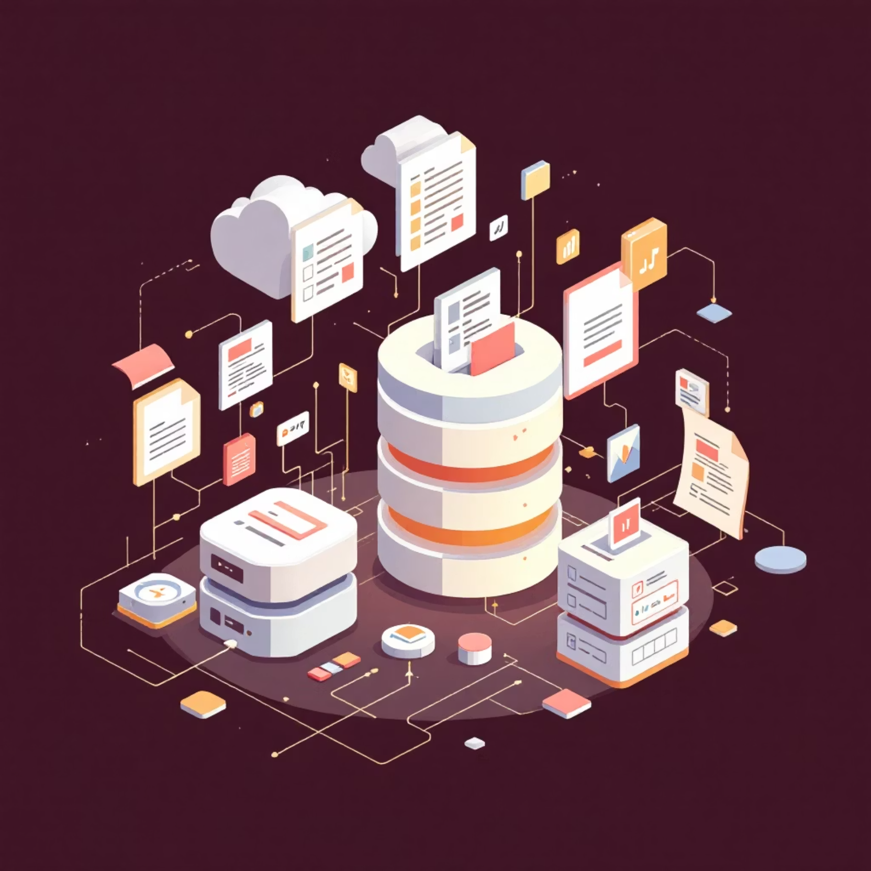
Data Flexibility
Gen AI applications often use diverse data types:
BigQuery
Best for analyzing petabyte-scale structured and semi-structured datasets
Firestore
Great for flexible, document-style data (unstructured or semi-structured) requiring real-time updates
For Trial
Notes:
**Speaker Note:**
"This slide highlights the data flexibility needed for Gen AI applications. We're showcasing two key Google Cloud data solutions. BigQuery offers powerful analytics for massive structured and semi-structured datasets. Firestore provides a highly flexible, real-time document database for unstructured or semi-structured data. We'll explore how these can be used together, and for the trial, [briefly mention how they will use these tools]."

Slide 8


Cost and Operational Efficiency
Storing huge amounts of data can be expensive.
Fully-managed databases like AlloyDB and Cloud SQL reduce the need for manual administration, which lowers operational costs.
When choosing a Gen AI database, consider both direct storage costs and the hidden costs of administration and maintenance.
For Trial
Notes:
**Speaker Note:**
"This slide highlights the importance of cost-effectiveness when selecting a Gen AI database. While storing large datasets is inherently costly, solutions like AlloyDB and Cloud SQL offer significant savings through reduced operational overhead. Remember to factor in not only the direct storage fees, but also the often-overlooked costs associated with manual administration and maintenance when making your choice. This is particularly relevant as you evaluate our trial offer."

Slide 9

Security and Data Protection
Encryption
Access Control
Advanced Security
Databases like AlloyDB, Cloud SQL, Spanner, and Firestore automatically encrypt data both at rest and in transit
Integration with IAM (Identity and Access Management) lets you control exactly who can see or modify data
AlloyDB provides extra features like model endpoint management to protect your application from malicious attacks
For Trial
Notes:
**Speaker Note:**
* This slide covers key security and data protection measures built into our databases.
* Emphasize the **automatic encryption (at rest and in transit)** in databases like AlloyDB, Cloud SQL, Spanner, and Firestore – a crucial feature for compliance and data privacy.
* Highlight **IAM integration for granular access control**, ensuring only authorized personnel can access sensitive data.
* Mention **AlloyDB's advanced security features**, particularly model endpoint management, offering additional protection against malicious attacks.
* **This is available for trial**, encouraging the audience to explore these features firsthand.

Slide 10
Key Takeaways
Different Needs, Different Solutions
Choose the Right Database
Vector Embeddings Are Essential
Consider vector search support, AI integration, scale, flexibility, cost, and security
AlloyDB, Spanner, BigQuery, and Firestore each excel in different Gen AI scenarios
They enable semantic search and understanding of unstructured data
The shift to Gen AI databases represents a fundamental change in how we store, retrieve, and understand data.
For Trial
Notes:
**Speaker Note:**
"This slide summarizes our key takeaways. Remember, vector embeddings are crucial for unlocking the power of unstructured data with Gen AI. Choosing the right database is equally vital, considering factors like vector search, AI integration, and cost. We've highlighted that there's no one-size-fits-all solution – AlloyDB, Spanner, BigQuery, and Firestore all offer strengths in different Gen AI use cases. The move to Gen AI databases is a fundamental shift in how we work with data. Finally, remember to explore the trial opportunities we're offering."

